Slide 2
Visual Document Testing
Using Robot Framework
Many Kasiriha (DB Schenker)

Slide 3
DISCLAIMER
The Library presented during this talk was developed by me for DB Schenker. Why? Because we needed it and we did not find an existing solution that made us happy. It was my first step into the open source world – and even though there‘s a lot of room for improvement – I‘m proud of it.

Slide 4

If you want
TO PLAY
Repo for this Talk
https://bit.ly/3BSew4M
GitPod URL
https://bit.ly/3SzZyXY
Repo of Document Testing Library
https://bit.ly/3LLCfs7

Slide 5










What‘s Visual Document Testing?
And why do I need it?
Reference
Document
Candidate
Document
Test Report

Slide 6

It‘s like finding the differences
In Two similar pictures...

Slide 7
Visual
*** Settings ***
Library DocTest.VisualTest
*** Test Cases ***
Compare two Beach images
Compare Images Beach_left.jpg Beach_right.jpg
Comparison
Compare two images or documents visually
Fails if different
Generates report with differences

Slide 8
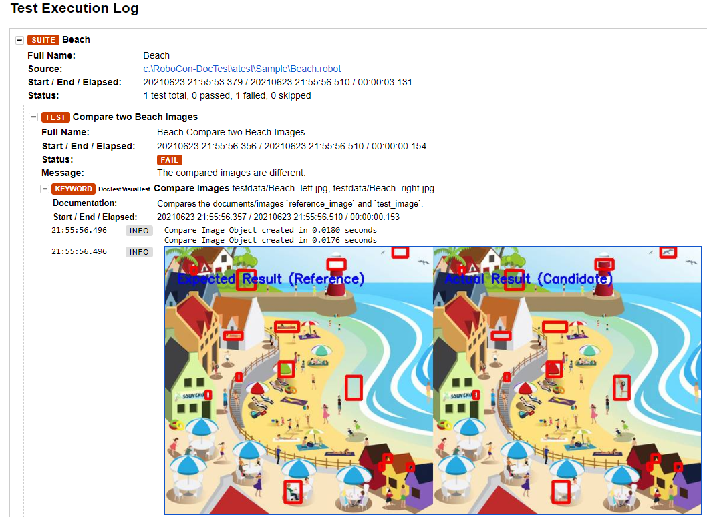

Slide 9
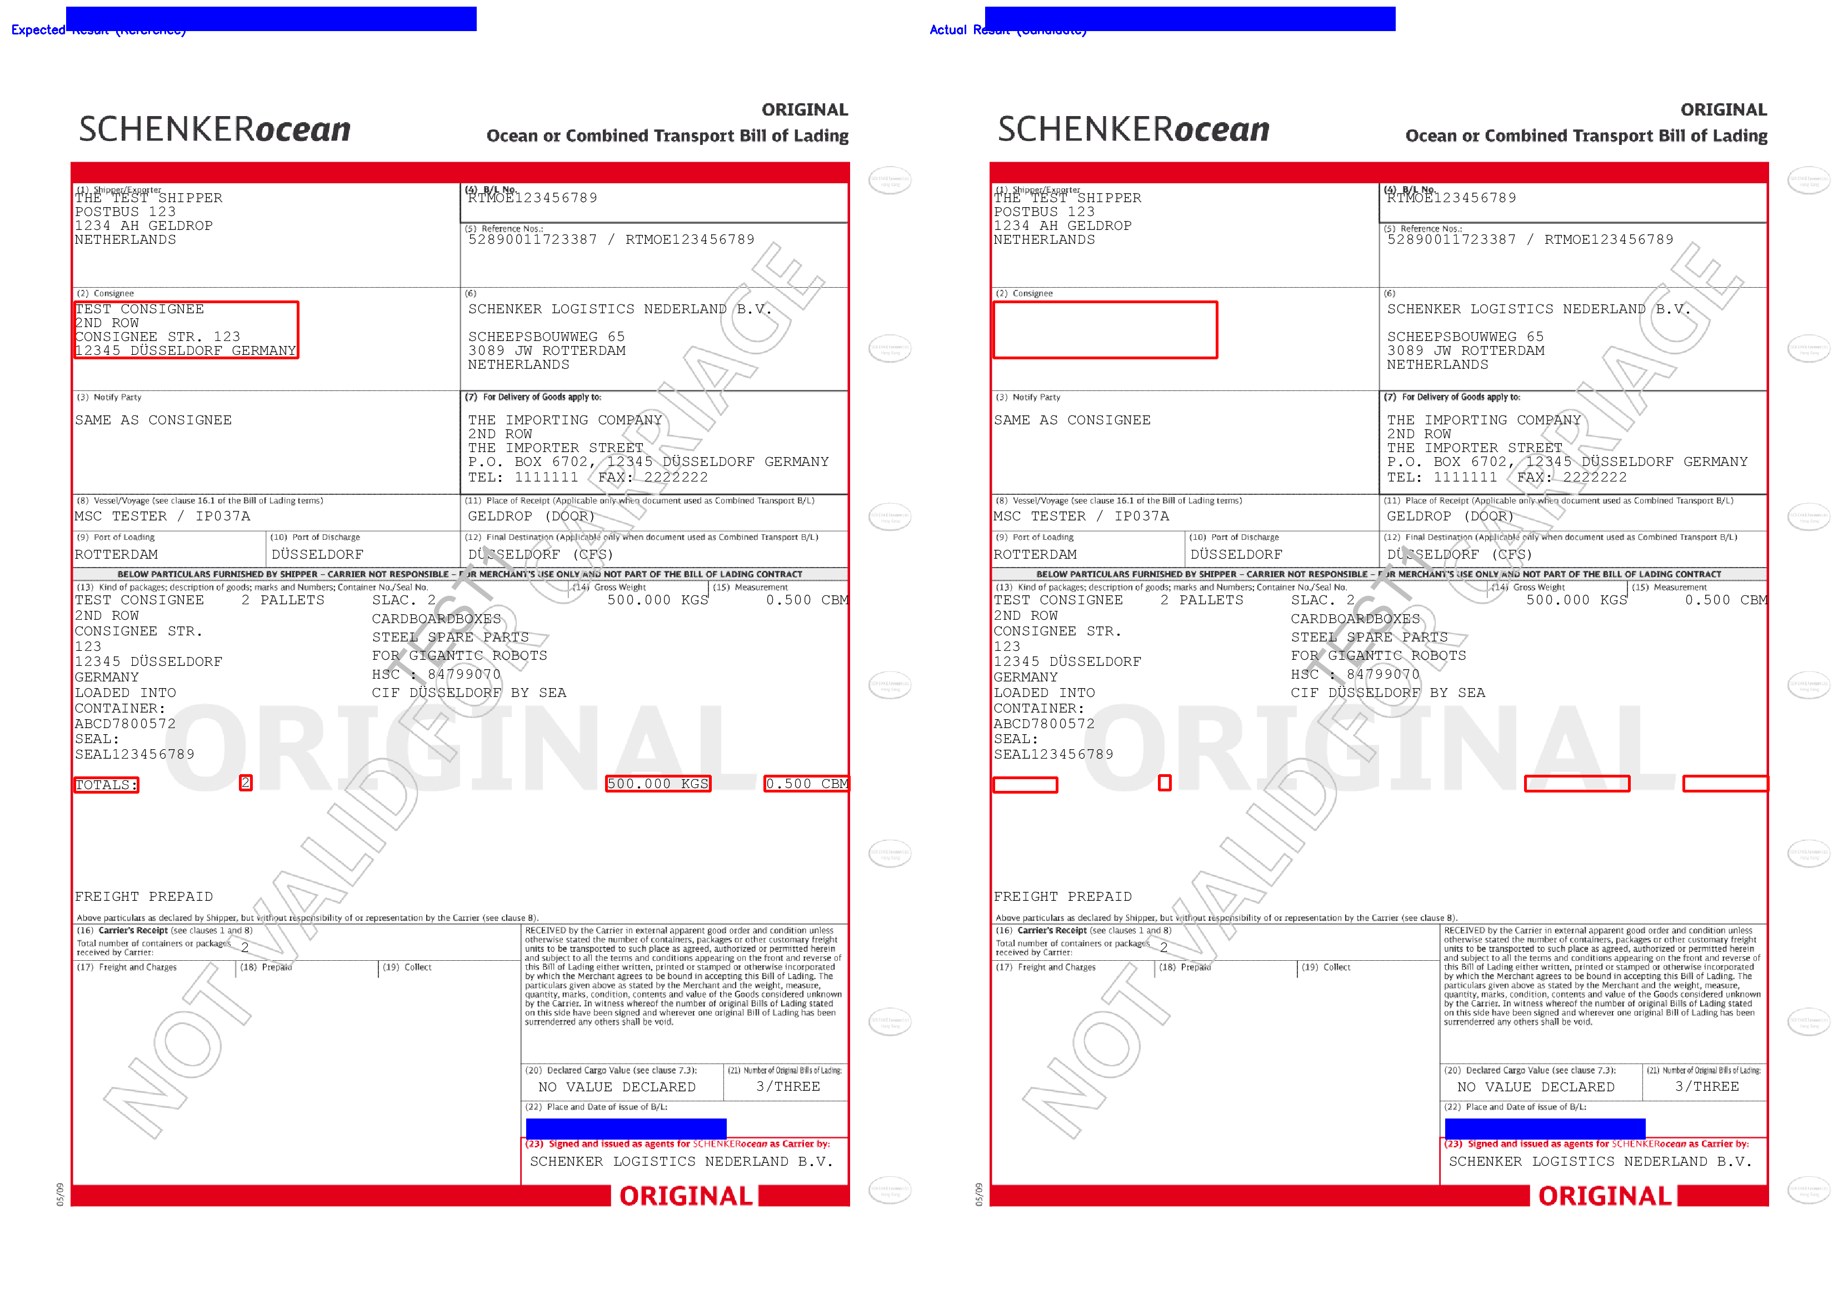

In Reality, it‘s more like this

Slide 10
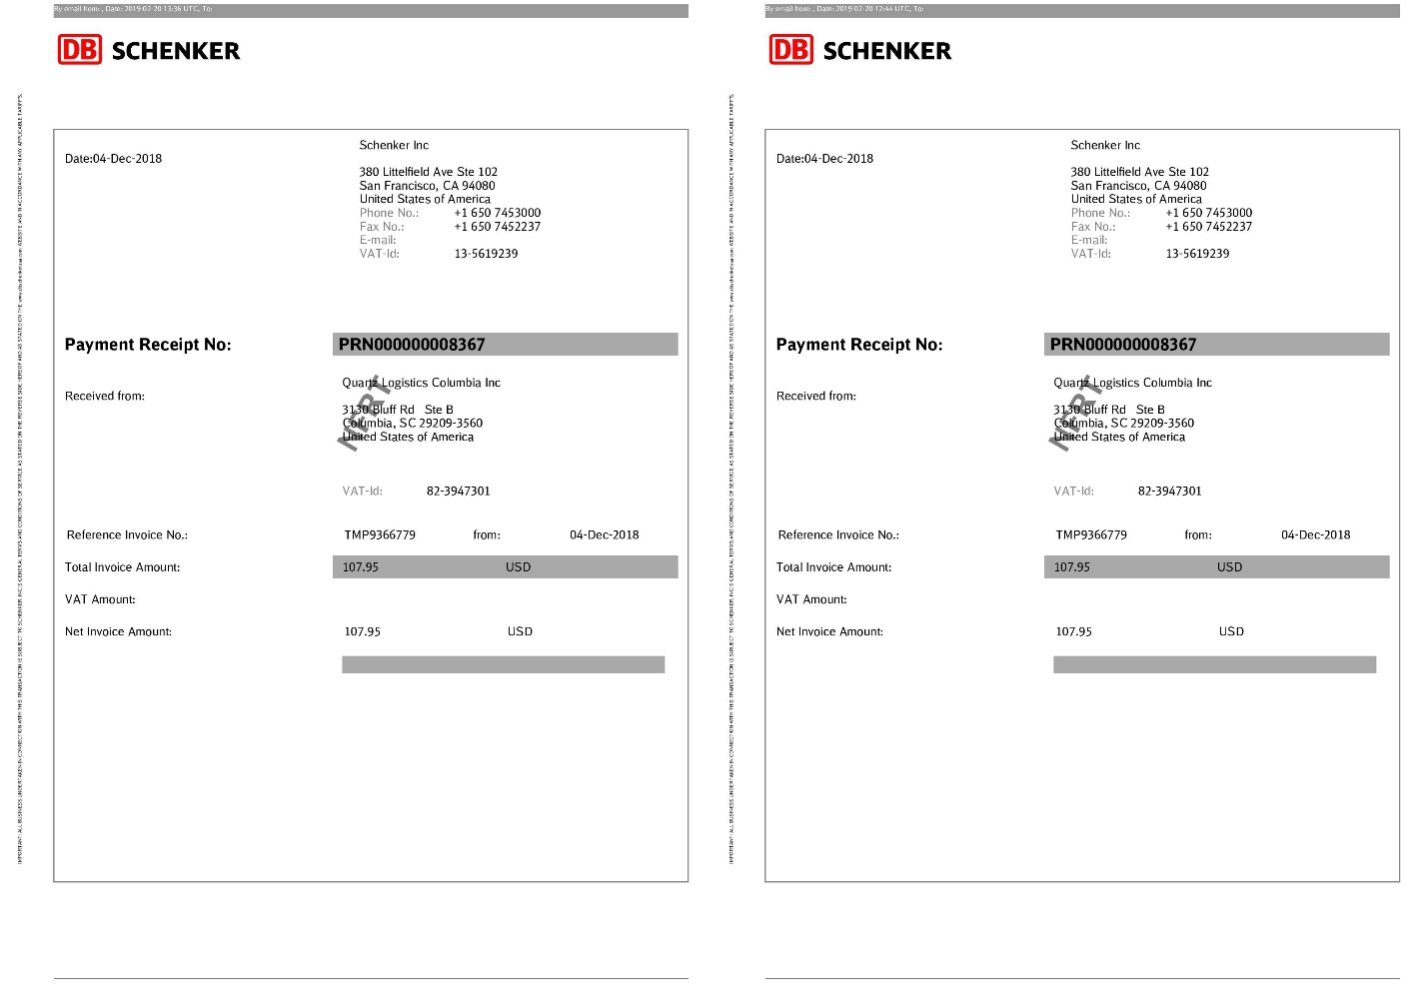
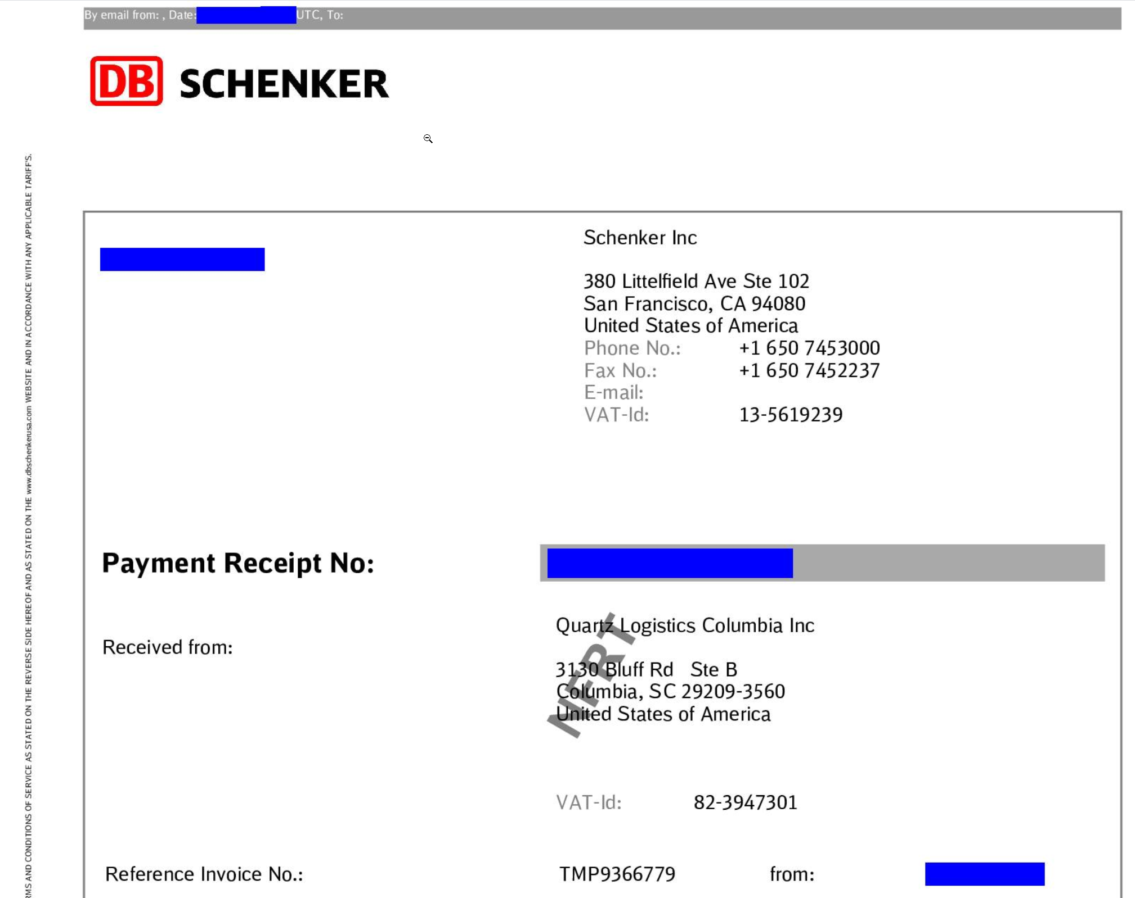
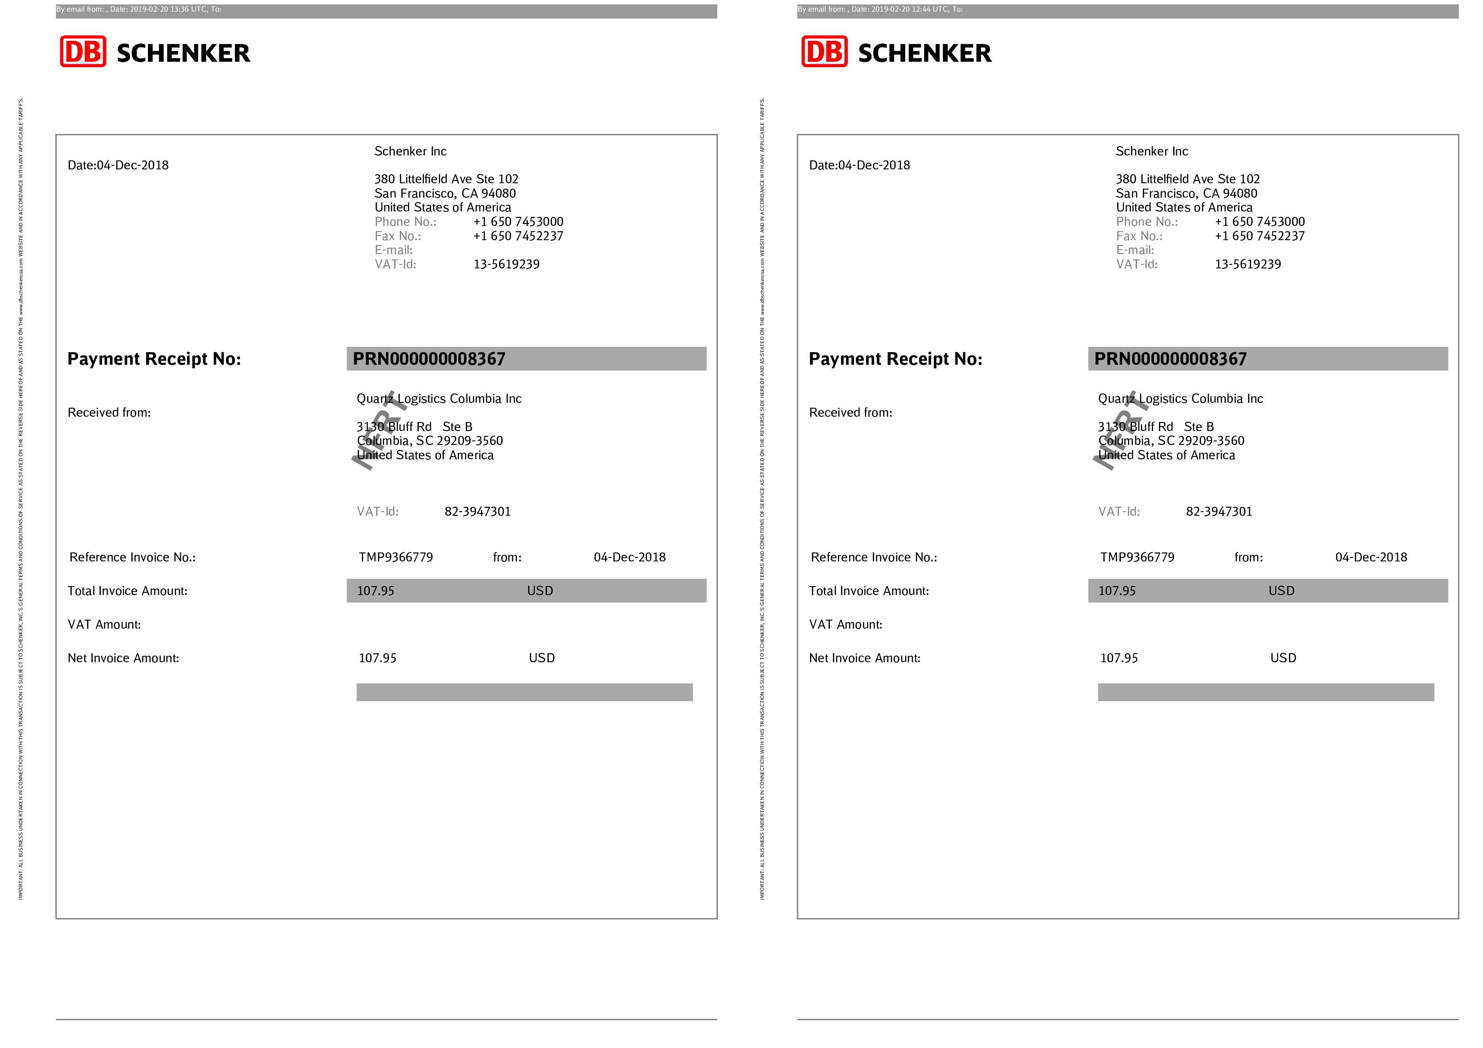


And Sometimes there is even
Dynamic data to IGNORE

Slide 11
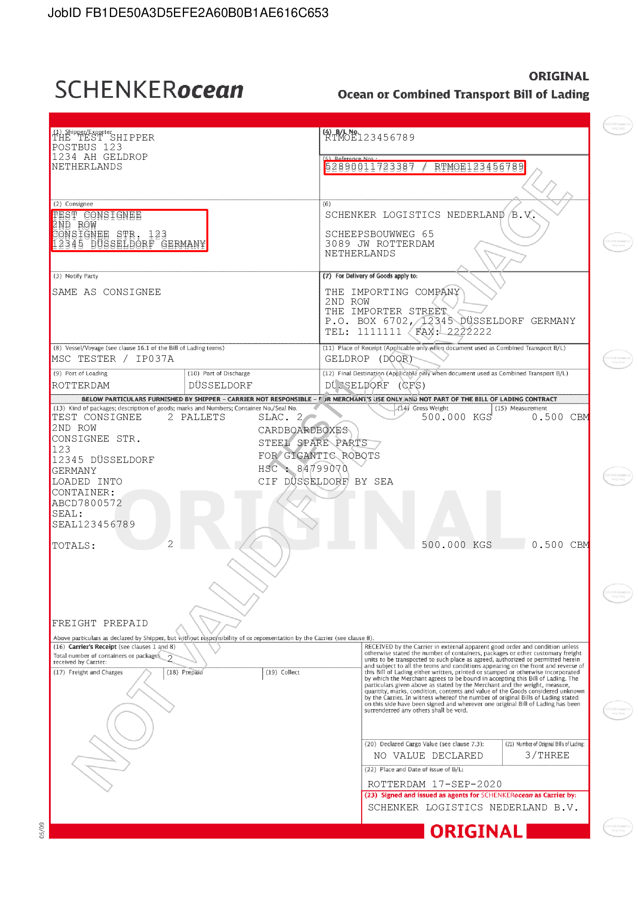
Or ACCEPTABLE SMALL DIFFERENCES
Moved Textblock by max. 10 pixels?
Same Text Content in changed area?

Slide 12
Visual Document
Testing
Let‘s Play
Examples: 01, 02, 03

Slide 13
Why?

Slide 14

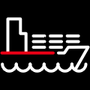




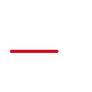

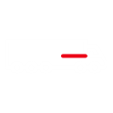
Document Testing at DB Schenker?
Isn‘t Freight ForwarDING about other things..?

Slide 15





Yeah, but..
It‘s also about DOcuments

Slide 16
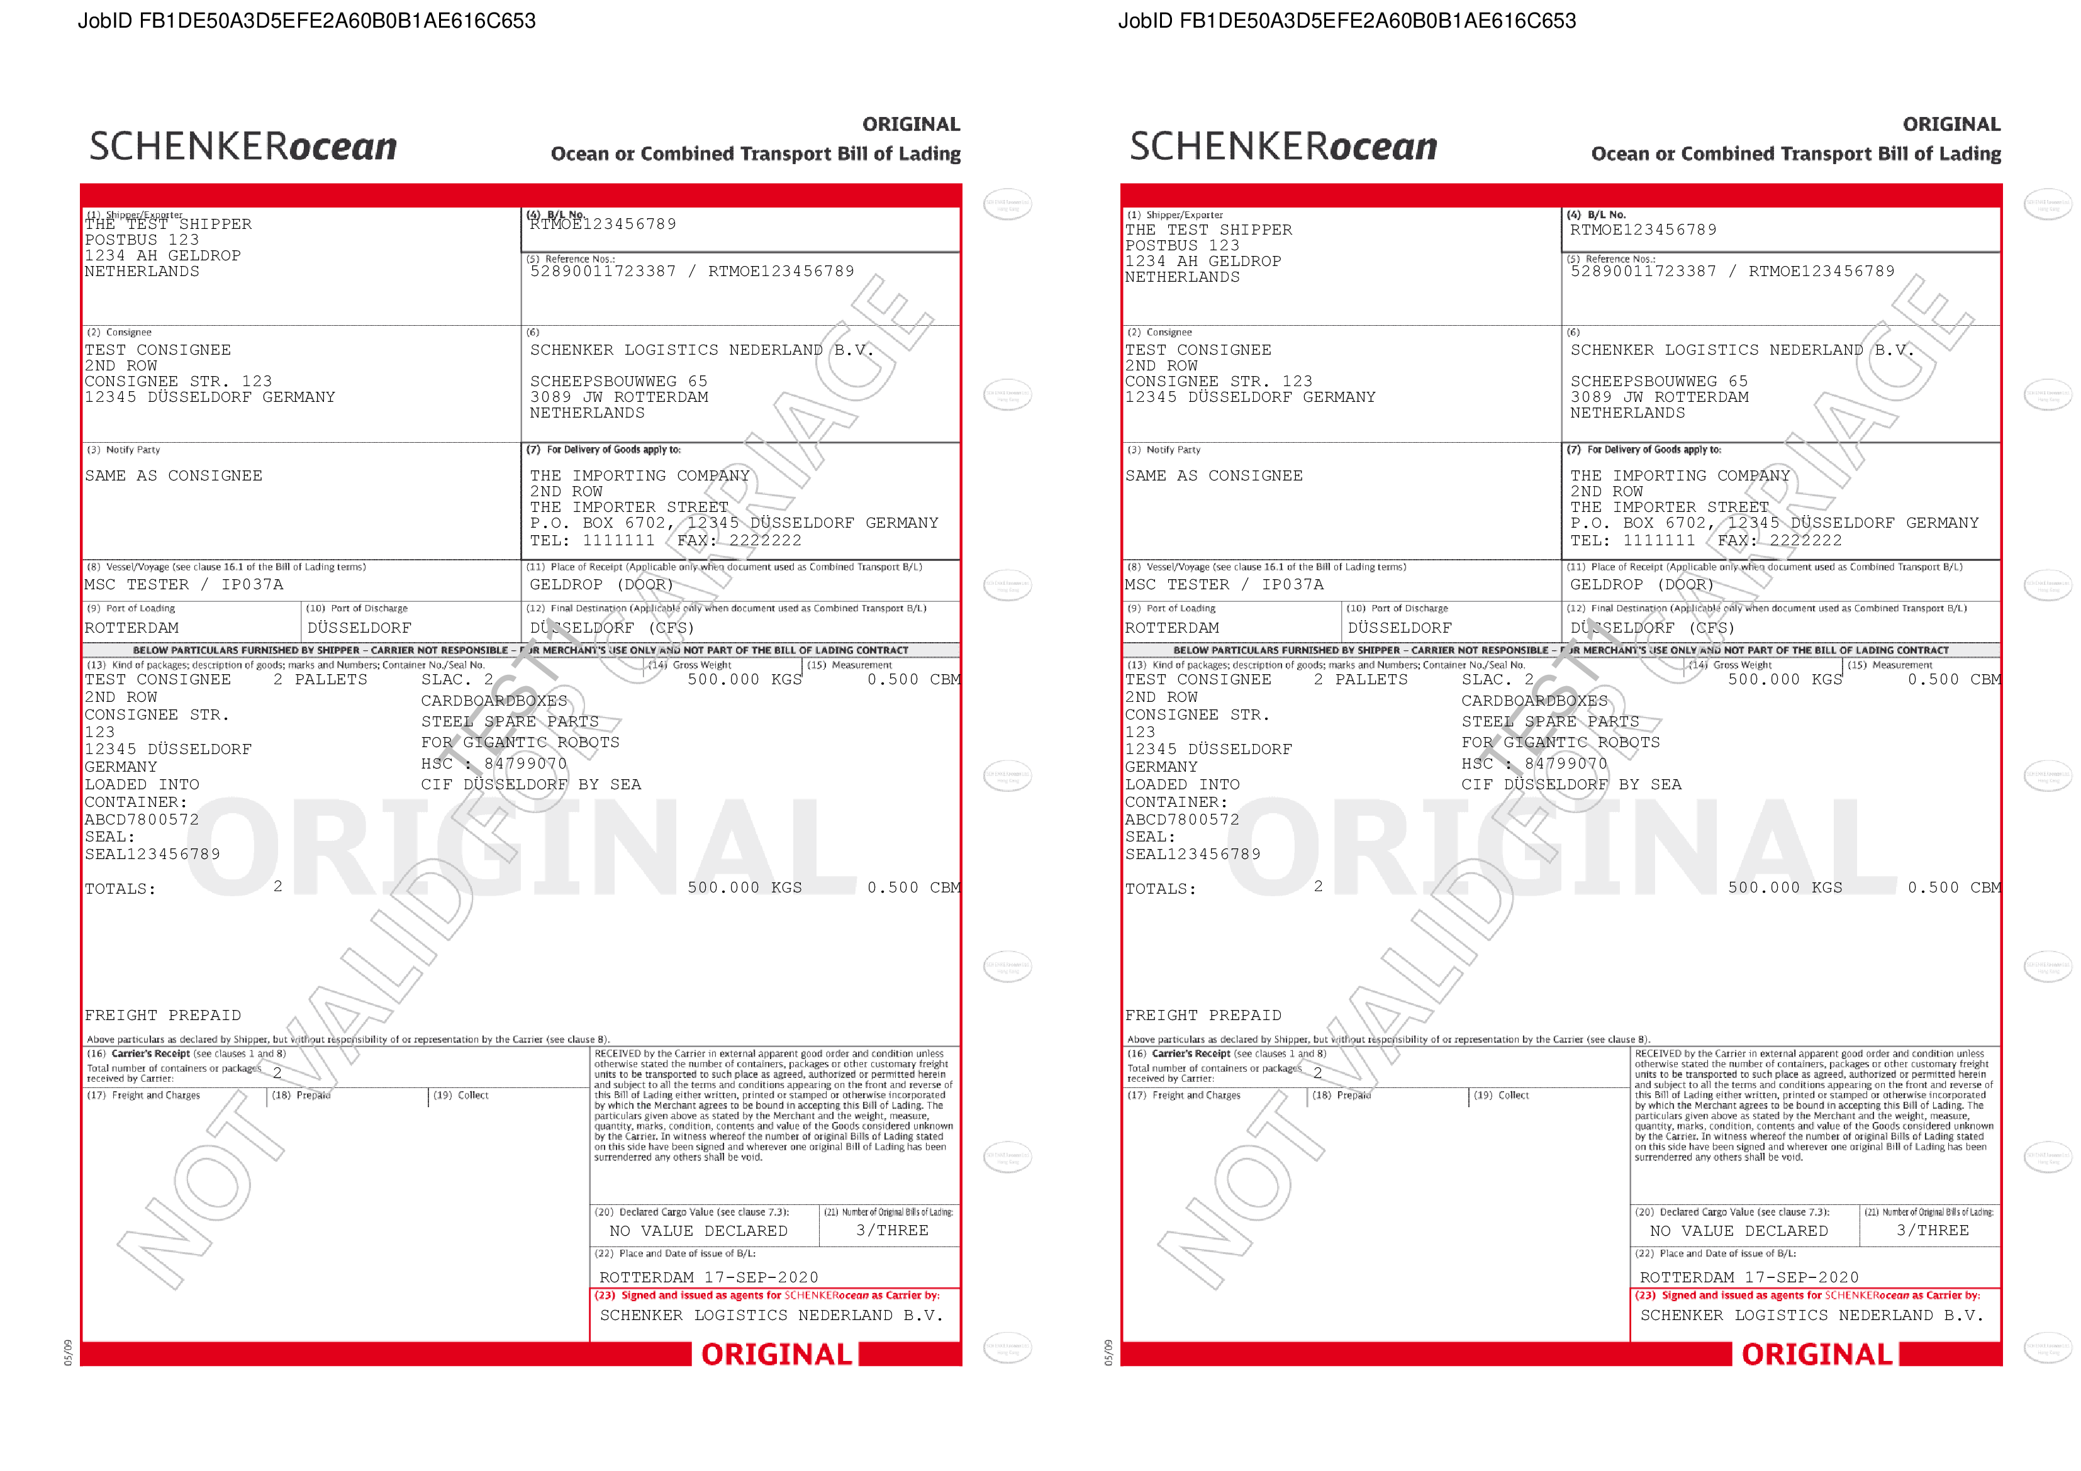

Output ManageMent Systen
Simplified
<xml>
Output
Management
System

Slide 17





Output Management System
A bit more realistic
<xml>
Output
Management
System

Slide 18
Why Robot Framework?
And why did we build a Library?

Slide 19





You need to get the Document
Before you can test it
Retrieve Outputs from a Database
Retrieve Outputs from Mailbox
Retrieve Outputs from Filesystem
Connect to Server Filesystem via SSH
Retrieve Outputs from a Webservice
Retrieve Output as response to a Webservice request
Retrieve Outputs from SMS
Fake SMS by sending as eMail and retrieve from Mailbox
Access Office 365 Mailbox via Microsoft Graph API
Execute SQL statement and store Binary Object

Slide 20
Build
Or Buy ?
What we wanted
Small & Serverless
Extendable
Different Interfaces
Flexible ignoring of areas
Content Comparison
A VW Up! instead of a Maybach
Give something back to the Open Source Community

Slide 21
Features
Visual Document Testing
Different Filetypes
Images, PDF, PCL, Postscript
Visual (pixel wise) comparison of outputs
Use masks to ignore areas
Coordinates, Text Patterns or Areas
Reading and masking barcode content (not presented)
Compare text value for changed areas
Allow moved text blocks within a defined range
Test Report highlighting changed areas
Remove Watermarks

Slide 22
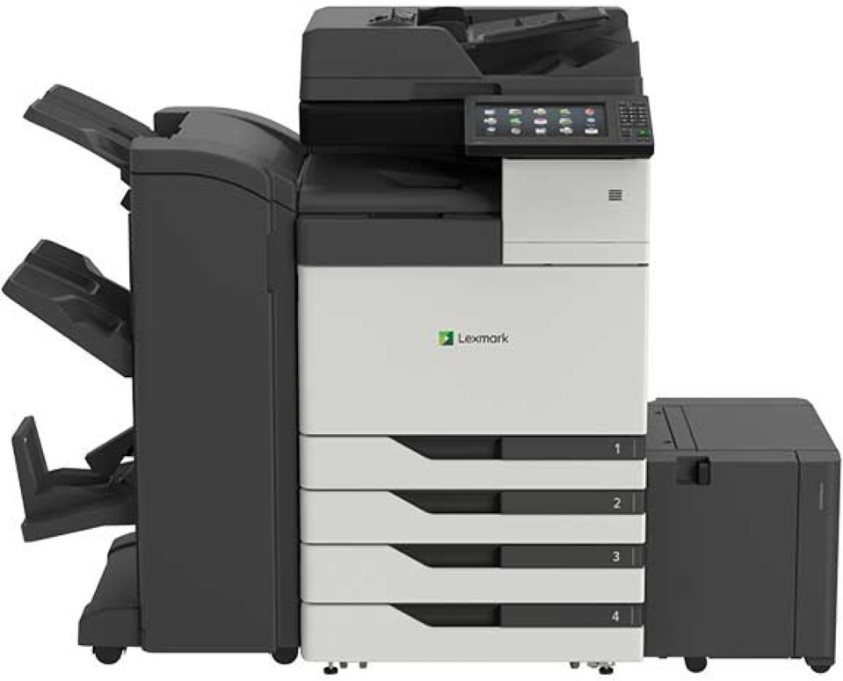
Visually Identical
= Printed Identical ?
Trays (for each page)
Duplex Printing
Paper Types and Formats
Binding
..

Slide 23
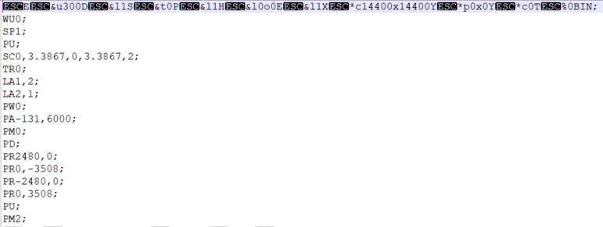
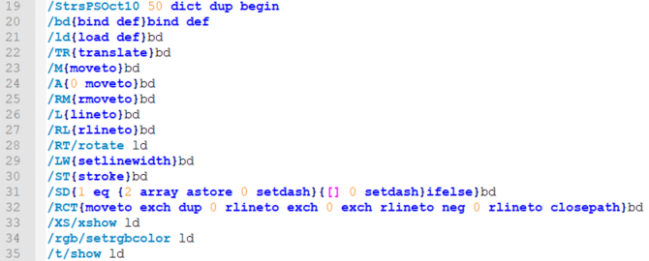
Print Jobs
Examples
PCL File
Postscript File

Slide 24
Features
PDF Content Testing
Check Text in Document
Single Strings or Lists
Compare Data between Documents
Text
Metadata
Fonts
Images
Signatures

Slide 25
Features
Print Job Testing
PCL and Postscript Files
Check single properties
Compare two print job files
PCL
Paper Source
Copies
Duplex
Page Format
Page Orientation

Slide 26
Features
Print Job Testing
PCL and Postscript Files
Check single properties
Compare two print job files
Postscript
Comments
Pages
Features
Header
Setup
Trailer
PJL Commands

Slide 27
Content and Print Job
Testing
Let‘s Play
Examples 04, 05

Slide 28
Mass Testing and Result Evaluation

Slide 29
What do we need
for Mass Testing?
Data Driver Library
Pabot
A tool to quickly evaluate results
Docker Image

Slide 30
*** Settings ***
Library DocTest.VisualTest DPI=${DPI} watermark_file=${REFERENCE_DIR}${/}watermarks show_diff=${true}
Library DataDriver file=evaluator_sample.xlsx
Test Template Compare Documents
*** Variables ***
${REFERENCE_DIR} ${CURDIR}${/}..${/}testdata${/}image
${CANDIDATE_DIR} ${CURDIR}${/}..${/}testdata${/}candidate
${PAYLOAD_DIR} ${CURDIR}${/}..${/}testdata${/}payload
${MASK_DIR} ${CURDIR}${/}..${/}testdata${/}masks
${DPI} 72
*** Test Cases ***
Create ${payload_file}

Slide 31
Test Template
Compare Documents
[Arguments] ${reference_image} ${payload_file}
... ${placeholder_file} ${check_text_content}
... ${move_tolerance} ${contains_barcodes}
... ${get_pdf_content} ${DPI} ${retrieve_output}
[Teardown] Copy Files for Failed Comparison
... ${PAYLOAD_DIR}${/}${payload_file} ${REFERENCE_DIR}${/}${reference_image} ${candidate_file}
IF $retrieve_output == 'archive'
Log Some logic to retrieve document after generation
${candidate_file} Get Document From Somewhere
END
Compare Images
... reference_image=${REFERENCE_DIR}${/}${reference_image}
... test_image=${candidate_file}
... placeholder_file=${placeholder_file}
... check_text_content=${check_text_content}
... move_tolerance=${move_tolerance}
... contains_barcodes=${contains_barcodes}
... get_pdf_content=${get_pdf_content}
... DPI=${DPI}

Slide 32
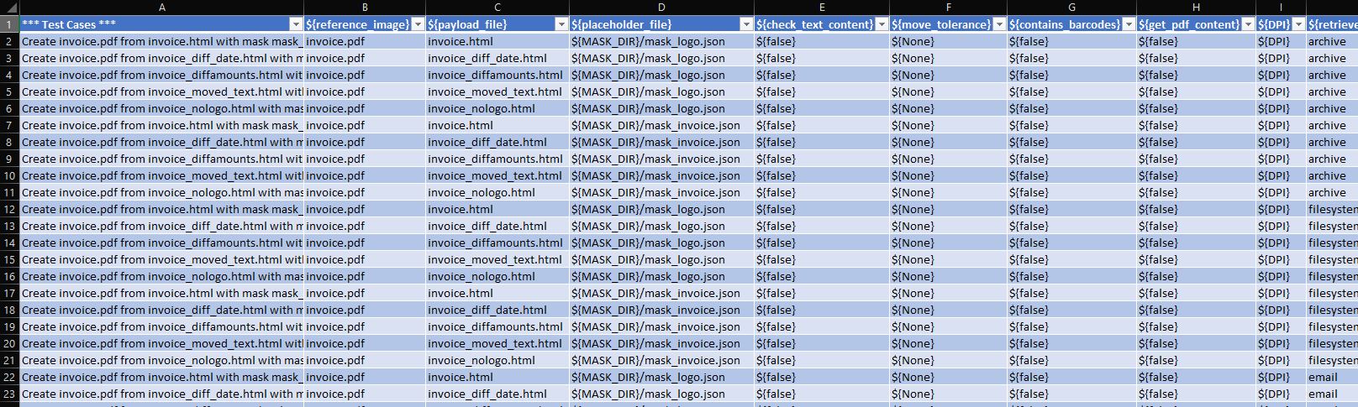
The DATA SHEET

Slide 33
Run Tests
With Pabot AND/OR Docker
# Some examples to run from project root
# Running with Pabot
pabot --testlevelsplit --processes 8 --artifacts png,jpg,pdf,xml --artifactsinsubfolders tests/
# Running in a Docker Container (windows)
docker run -t -v "%cd%":/opt/test -w /opt/test robotframework-doctest robot tests/
# Running in a Docker Container (linux)
docker run -t -v $PWD:/opt/test -w /opt/test robotframework-doctest robot tests/

Slide 34
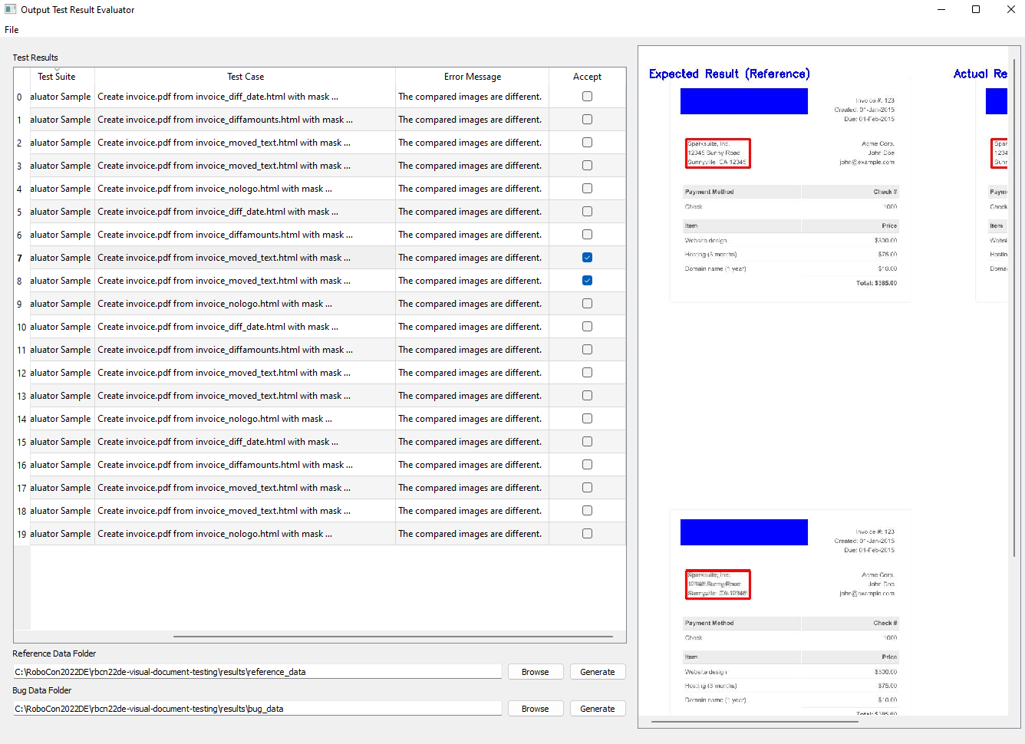
Output Test REsult
Evaluator
View screenshots
Filter & Sort
Accept Changes and generate new Reference data
Collect Data for Defect creation

Slide 35
Content and Print Job
Testing
Let‘s Play
Example evaluator_sample

Slide 36


Many Kasiriha
QA Engineer @ DB Schenker
@ManyDefects
manykarim
@many

Slide 37
Y
E
S
W
E
`
R
O
P
E
N
S
R
C

